Slide 1

Proof (Part I)
Master Method
Design and Analysis of Algorithms I

Slide 2
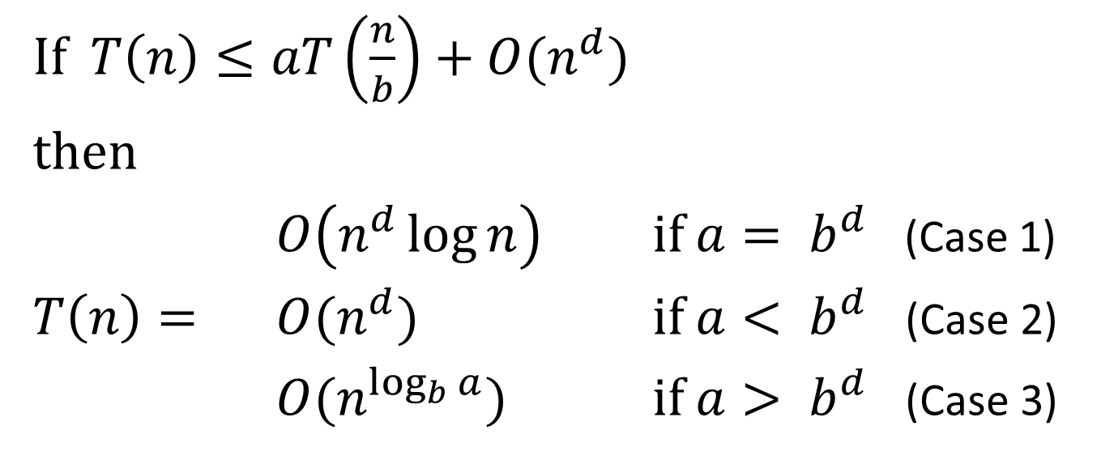
The Master Method
If $T\left(n\right)≤aT\left(\frac{n}{b}\right)+O(n^{d})$
then
$O\left(n^{d}\log{n}\right)$ if $a= b^{d}$ (Case 1)
$T\left(n\right)=$ $O(n^{d})$ if $a< b^{d}$ (Case 2)
$O(n^{\log_{b}{a}})$ if $a> b^{d}$ (Case 3)

Slide 3
Preamble

Slide 4
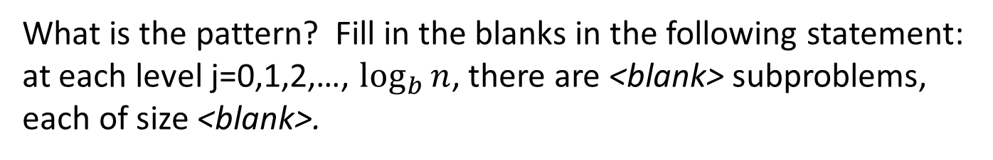
What is the pattern? Fill in the blanks in the following statement: at each level j=0,1,2,…, $\log_{b}{n}$, there are <blank> subproblems, each of size <blank>.
$$\text{a}\text{j} \text{and} \text{n}\text{/}\text{a}\text{j}\text{, }\text{respectively}\text{.}$$
$$\text{a}\text{j} \text{and} \text{n}\text{/}\text{b}\text{j}\text{, }\text{respectively}\text{.}$$
$$\text{b}\text{j} \text{and} \text{n}\text{/}\text{a}\text{j}\text{, }\text{respectively}\text{.}$$
$$\text{b}\text{j} \text{and} \text{n}\text{/}\text{b}\text{j}\text{, }\text{respectively}\text{.}$$

Slide 5
The Recursion Tree

Slide 6
Work at a Single Level

Slide 7
Total Work

